Slide 1
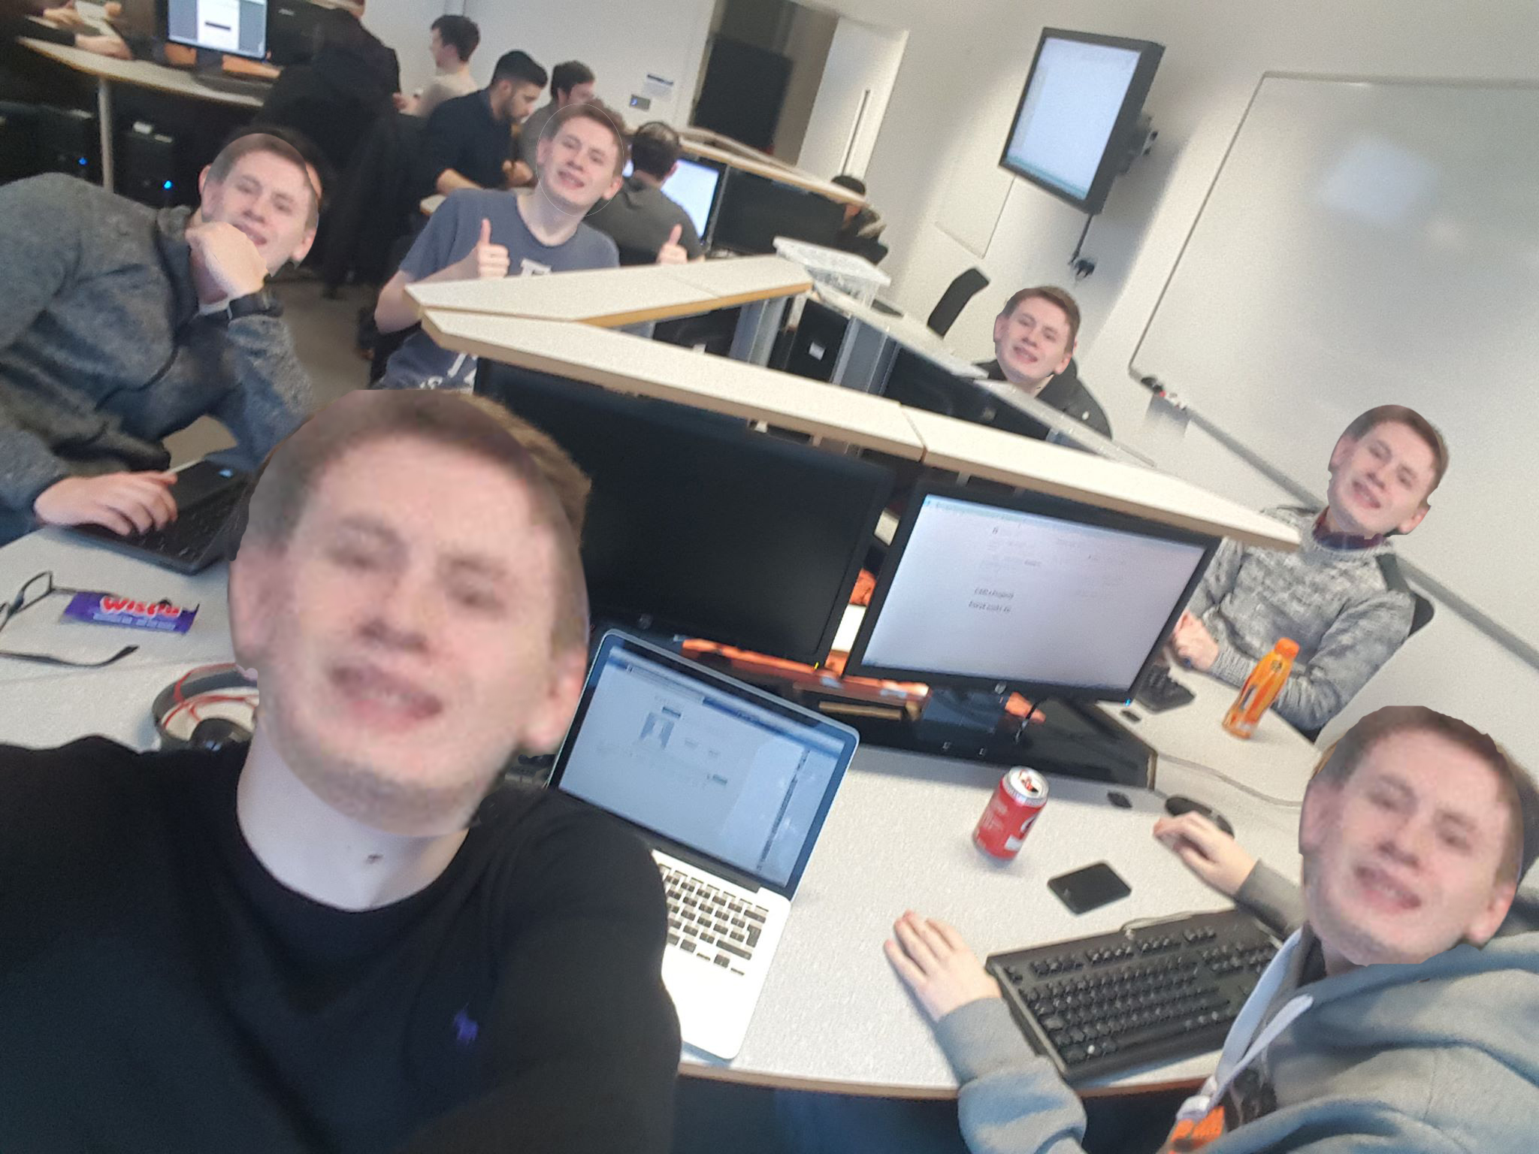
👻Space Hunt👻🖕
Jamie Euan Erik Conor Tom Patryk

Slide 2
Initial Idea
Birds eye view game
Cityscape background
Searching for bargains in a city
Going inside shops etc.

Slide 3
Final Idea
Space Bargain hunt (Called Space Hunt)
Searching for minerals, materials etc. throughout different galaxies and planets
Spaceship being the Player Controlled Object
Gravity implemented around planets
Fuel indicator
Speed indicator

Slide 4
Algorithms we used (Sorting)
Merge Sort
It breaks down the array into smaller chunks and then reorganises them to form the sorted list.
Its used in the program to sort the inventory list ordered by the numeric value (price)
We needed a fast sorting algorithms due to the fact that Pygame has struggled with memory and performance right from the start.

Slide 5
Algorithms We used (Searching)
Dijkstras Algorithm (Sorry still in implementation)

Slide 6
Working example

Slide 7

What went well
The program has developed from the initial idea
A lot more functions have been added
GUI Looks good
Player control function enabled
Python and C++ knowledge improved

Slide 8
What could be improved
Communication
Group roles
Having ACHIEVABLE GOALS

Slide 9

What changed during the project
The switch from 2D to 3D
Language change from Python to C++ (WHY?!)

Slide 10
Difficulties we faced
Learning C++ Language from scratch
Learning GUI programming
Getting to work with GITHUB
Creating the searching algorithm

Slide 11
CODE PRACTICES
Commenting Code
Grouping together similar functions
Saving files with suitable names
Commit messages

